Slide 1
Parallel Discussion Sessions
Review of Topics
Gregory Marr, BNL
Julian Brower, STFC/ISIS

Slide 2
Parallel Discussion I: Automation vs operator skills
Moderator: Petra Schuett of GSI
Automation is more and more present in every control room.
How much can realistically be automated?
Which tasks are automated in your facility?
What is the result: Is beam quality / availability better in the automated version?
Which tasks remain to be done by the operators?
Do operators lose the skills to perform complex tasks?
What is the minimum staffing with automation? Could it be 0?

Slide 3
Automation vs operator skills
Moderator: Petra Schuett of GSI
The degree of automation increases with time.
Synchrotron light sources generally are much more automated than hadron machines like RHIC e.g.
A task often automated in light sources is injection of new electron beam or top up injection.
Several people felt, that a minimum frequency (1 or 2 per week) of active interaction with the machine is necessary to keep the skills and knowledge of the operators up. Examples were “manual” injection or a thorough check of machine behavior.
Sometimes, automated sequences of tasks are much faster than manually doing could be. In those cases, operators must be taught offline, what’s behind.
Generally, software is seen to be less error-prone than humans in repeating tasks.
What still needs human intervention is trouble shooting or personal safety issues.

Slide 4
Parallel Discussion I: Operators’ tasks while not on shift
Moderator: Jon Bonofiglio FRIB
What categories do operator projects fall under?
Hardware?
Software?
If software, is the laboratories software repository used for version control, rollout and future support?
Are these projects owned by the operations group or are they in support of other groups (RF, Controls, etc.)
Are operators hired with special skills, knowing they can support other groups, or are operators asked what they desire to work on?

Slide 5
Operators’ tasks while not on shift
Moderator: Jon Bonofiglio FRIB
The conversation about Operator Tasks While Not On Shift focused less on the specific tasks and more on the need for these “secondary” projects.
Some laboratory administrations want total concentration by the operators during the running of the machine
The operators are utilized during maintenance shutdowns by groups needing specific skills the operators may have
Most administrations see the benefit of operators having secondary projects as a key factor in retaining operators within the organization.
These secondary projects also benefit the operators as giving them a career path out of operations should they desire
One organization gets their operators from other groups within the laboratory
This keeps those employees from becoming bored with their core responsibilities (Controls, Power Supply, RF, etc.)

Slide 6
Operators’ tasks while not on shift
Moderator: Jon Bonofiglio FRIB
An additional benefit of using operators in a support role for maintenance is the operators gain a deeper understanding of the machines
These understandings give the operator perspective on how their actions controlling the accelerator affect the operability of the accelerators
Laboratory unions sometimes have an affect on what the operators can take on as a secondary project.
A Memorandum Of Understanding (MOU) between the union and administration may be needed to allow operators to help out in such organizational structures.

Slide 7
Operators’ tasks while not on shift
Moderator: Jon Bonofiglio FRIB
Conclusion
Operators having secondary projects is more important than what specific project and individual may have
Having secondary projects prevents boredom among the operators, therefore prevents turnover within the organization
Having secondary projects gives the operators more experience and a larger skill set
Allowing the operators to have secondary projects serves the organization by giving it a more experienced work force

Slide 8
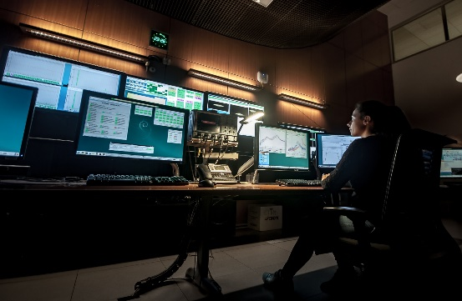
Parallel Discussion I: COMMUNICATION AND SHIFT-WORK
Moderator: Laurent HARDY – ESRF
Operator on shift work
By definition, operators working on shift work are ‘isolated’ from the remaining staff. How can they communicate :
Internally ? (depends on how many operators in the group: CERN = 80 operators ! Often : 8 operators).
Between themselves when not on the same shift ?
- preferred way is generally emails. No golden solution unless interfering with private life (Zoom at home – OK if teleworking time but not on holidays !)
2. Operation group meetings
- majority : weekly meeting with those who can attend (then minutes by email for others)
- In some cases: operation meetings during shutdowns for Institutes where operators are not on shift during shutdown: all can attend !

Slide 9
Operator on shift work
COMMUNICATION AND SHIFT-WORK
Moderator: Laurent HARDY – ESRF
Internally (cont’d)
Pass on the right information to the next colleague on shift (shift hand-over) :
Generally overlapping teams for 15 minutes.
If several operators in the team, one is generally designed as Shift Leader and will pass on the information to the next Shift Leader (one-to-one channel interaction) – CERN example.
Overlapping + formal way (ESRF example) : 15 minutes overlapping around a coffee + when connecting to the electronic logbook, next operator is automatically filtered with “Instruction in progress” and obliged to read them.
Communication between Operator and his-her Manager
- In some Institutes, it happens that some operators (mainly on night shift) do not meet their manager for weeks …
- Others Institutes, the Manager is part of the Shift Work Team
- E-mail is the preferred solution when there is a need for communication / discussion

Slide 10
2. Towards outside the Control Room :
With colleagues / experts on a daily basis
In some Institutes: only very few contacts with experts (Control Room is THE dedicated place for operators).
Others Institutes : informal way : experts and operators can meet in Control Room and exchange
ESRF case 1: Technicians/Engineers/Physicists are requested by contract to make occasional shift work in binoma with the Operators. This forces discussions and informal training between experts and Control Room operators.
ESRF case 2: For non urgent technical issues, operator writes his request in the e-logbook. The link of the record is automatically forwarded by mail to expert. Expert is supposed to answer in a special dedicated field (“reply from expert”).
With experts for urgent help (on-call system)
On-call system is used in most Institutes with different level of flexibility
In a Lab, any expert can be called 24/24 if considered necessary by the Operator, to solve urgent issue
In most Labs : 1 expert on standby for every sub-system. The operator is authorized to call ONLY the on-call. If the on-call can not solve the issue, the on-call (and NOT the operator) will decide to call others expert colleagues.
Some Labs: escalade system : Operator calls the Group Leader who will decide who to call next
COMMUNICATION AND SHIFT-WORK
Moderator: Laurent HARDY – ESRF

Slide 11
Parallel Discussion II: Training operators under high availability standards
Moderator: Violeta Toma, TRIUMF
Best unplanned training/learning opportunity: machine failure
Best planned training opportunity:
Development shifts
Machine start up
Training folded into setup (more time allotted for setup to allow training)
Shutdowns
Shift pairing (operator + expert)

Slide 12
Training operators under high availability standards
Moderator: Violeta Toma, TRIUMF
Training provided by:
Experienced operators
Experts
Other training forms:
External training: Accelerator School, research division (France)
Write failure reports
Intentionally created failures (can, and did lead to real failure)
Written procedures with pictures and instructions
Assign operators to work with support groups (side project or shutdown project)

Slide 13
Training operators under high availability standards
Moderator: Violeta Toma, TRIUMF
Determine who can deliver training based on:
Supervisor’s personal observation
Feedback from operators

Slide 14
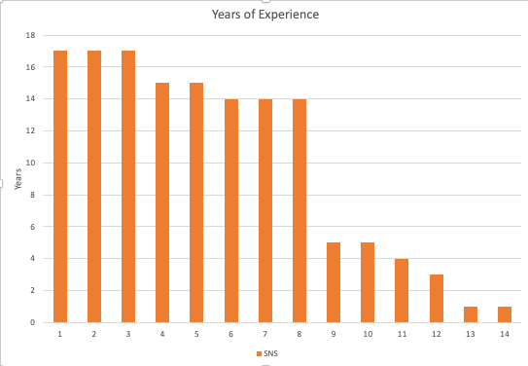
Parallel Discussion II: Career Development
Moderator: Greg Marr, BNL
Some do want to stay in place, which reduces turnover but also advancement.
Still, getting off shift is a large (the largest?) motivator.
Leaving shifts can be a pay cut.
Advancement within Operations can be a bit like a “Klingon Warship” – only if the Captain is lost in battle, then the promotion comes…
Operator progression:
Many facilities have multiple ‘levels’ within Operations, with years to navigate.
STEM positions can be rule-bound when it comes time to promote.
Human Resources views may conflict with Operations’ values.
Cooperation – former Operators, now in other groups, respond well to Operations’ needs and requests.
Many facilities see the high value in this. Some may actively seek Operators.
Suggestion: cooperation among facilities? Many would like to plan more collaboration…
SNS poll measured years experience in 14 of their Operators (Milanovich)

Slide 15
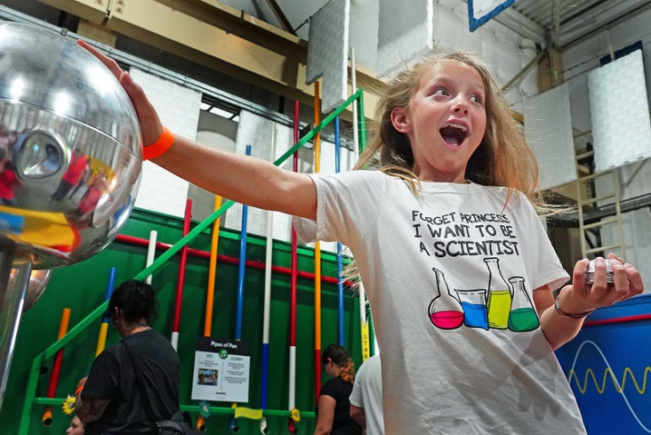
Career Development
Moderator: Greg Marr, BNL
Continuing education (for degrees) can be difficult. Some shift rotations may be more accommodating than others.
Online courses help somewhat.
In some facilities, degree level is not a large consideration.
Schooling is voluntary, and personal expense sometimes.
Suggestion: Require and reimburse training (US Particle Accelerator School or equivalent) once early in career; continue to reimburse more specialization on a volunteer basis
Lateral moves: assigned work is key to developing career path
We see “Operators Tasks While Not on Shift” echoing this.
Successful Managers take responsibility for career development, not just retention
Shift work can vary – 70%, 50% of total hours…
Find project tasks that meet interests, encourage specialization, provide deeper understanding

Slide 16
Parallel Discussion II: Machine learning for failure diagnosis
Moderator: Charles Peters ORNL-SNS
For your facility, how do operators diagnose failures currently?
Machine protection system
Soft interlocks with smart logic
Instead of machine learning make the machine protection system smarter
Look for abrupt orbit distortions and abort store before beam loss occurs
Add more signals to the MPS (BPMs, power supply current and voltage)
Alarm system
How does Operations initiate implementation of machine learning for fault prediction?
Record downtime and trip statistics with fault causes to focus direction of utilizing machine learning to guide maintenance/upgrade priority
Involve operators in programming/developing machine learning code

Slide 17
Machine learning for failure diagnosis
Moderator: Charles Peters ORNL-SNS
How is machine learning used? Which support groups are needed to help with implementation?
Depends on facility parameters
High duty factor the focus is on abrupt failure diagnosis (less focus on model and optimization of tune)
Lower duty factor the focus is slower trends
Model and optimization of tune
Cryogenics look for abnormal slow trends (oscillating valve trends for example)
Long term trends (magnet temps, weather, cooling towers, voltage, current)
Automation/machine learning and the impact on operators
Some are working on machine learning modules where users can enter their own data and easily run machine learning code

Slide 18
Gràcies! Thank you!
Your participation in these Sessions make for a great WAO!
Thanks to the helpful Moderators!

